Slide 1

Impact of
Societal and Cultural Issues on the Learner
The Need for Understanding, Empathy, and Support
Presented by: Andres Garcia

Slide 2
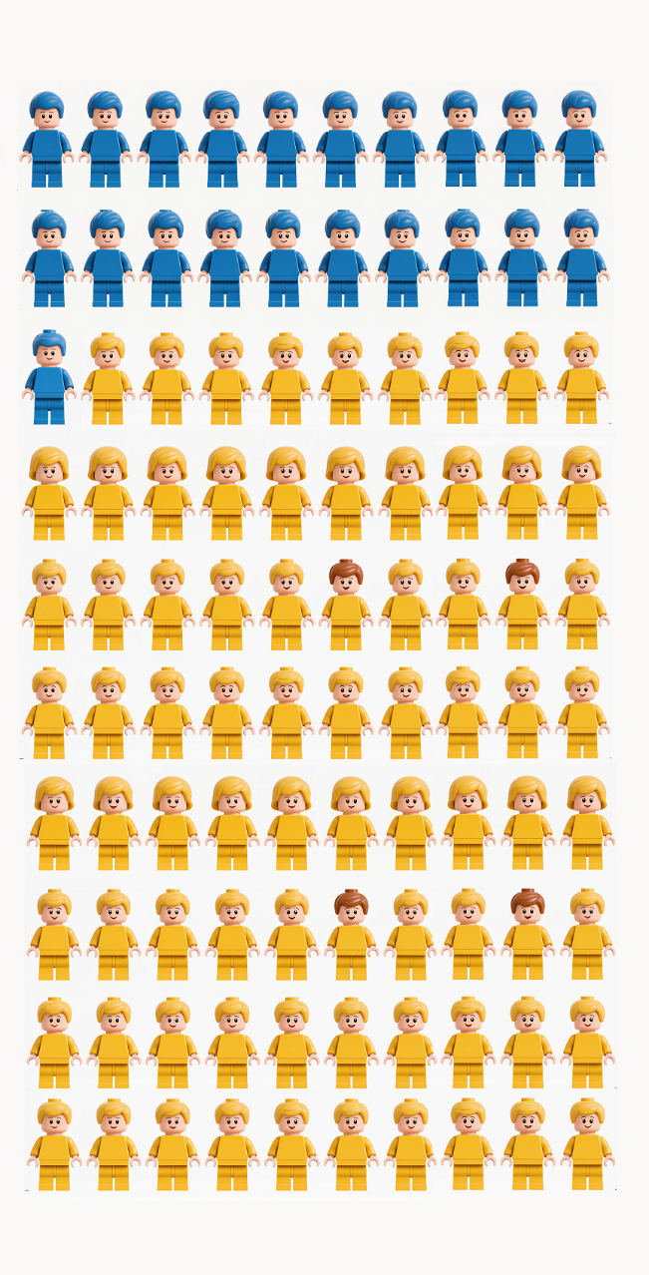
Introduction: We All Hurt Sometimes
As educators in Texas, we must recognize the fact that students in our classrooms come from a wide variety of different backgrounds. Many come from very stable households with very supportive parents. Some have families that can readily meet all of their financial needs. However, many students in our classrooms come from backgrounds where this is not the case.
Nearly 1 out of every 5 students nation wide has found themselves dealing with a situation so daunting that it has caused some form of mental, emotional, or behavioral health condition. (CDC, 2021)
Together, we will look closely at four hypothetical students facing situations that are very realistically representative of what many students actually face every day. In each situation, we will first identify the issue at hand. Then we will explore ways to identify the issue in the classroom, how it impacts student achievement, and how we can work to best support actual students who are facing similar situations in real life.
Twenty-one percent (21%) of children ages 3 to 17 have been diagnosed with a mental, emotional, or behavioral health condition. (CDC, 2021)

Slide 3
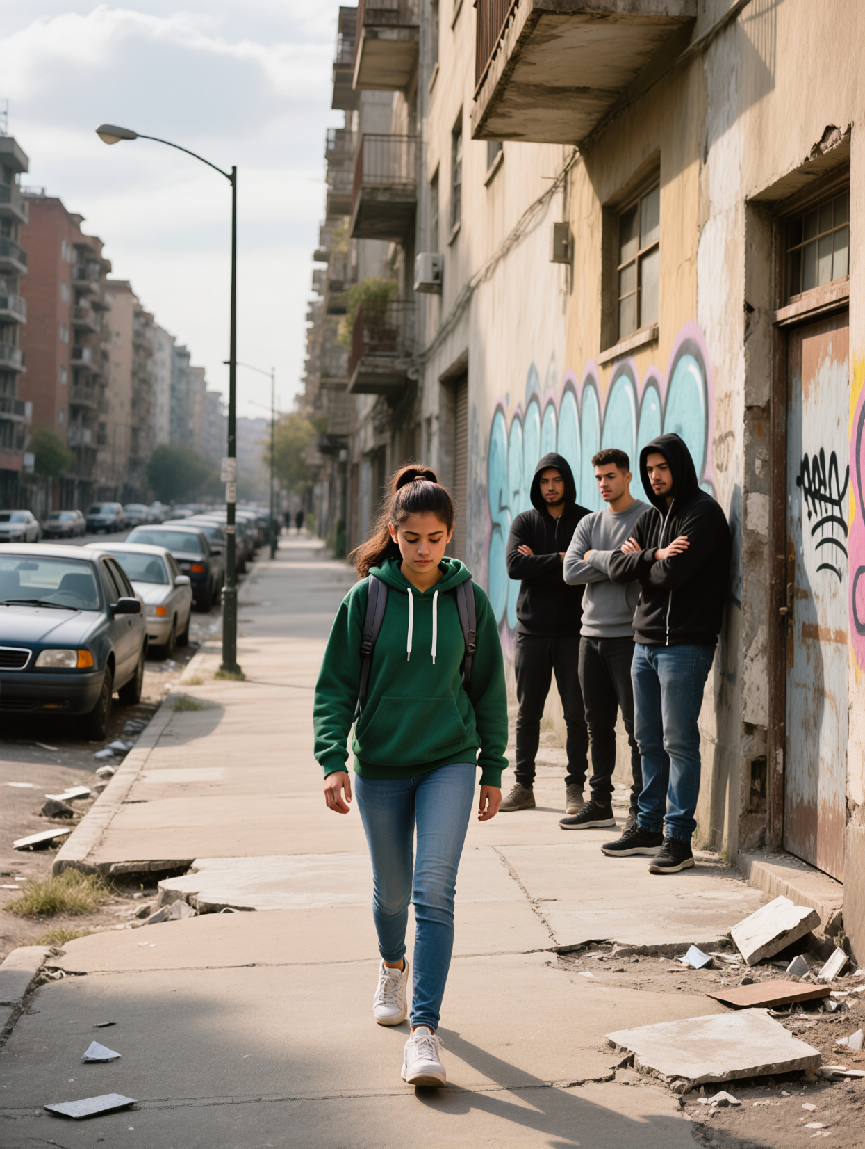
Nelly: Poverty and Complex Trauma
Nelly lives in fear and powerlessness caused by poverty and crime. Her neighborhood is riddled with drugs and crime so she is always on guard for her safety. Knowing that her grandparents can not afford to move to a safer place feeds her feeling of powerlessness to change her unsafe situation.
Still, Nelly is not just giving up. She does things like acting tough so she won’t get picked on. As a result though, she is preoccupied with survival and unable to ever fully focus on school. This has resulted in a history of poor academic performance.
“Fear and anxiety over time can alter a child’s brain development.” says Patricia Olney Murphy LICSW, MPA. Witnessing crime, violence, and abuse regularly can lead to a feeling of chronic danger. This feeling is symptomatic of an experience known as Complex Trauma. According to Murphy, it causes intrusive thoughts, dissociation, and flashbacks which can render a student’s brain effectively “offline” for learning. (Gunn, J. 2018)

Slide 4
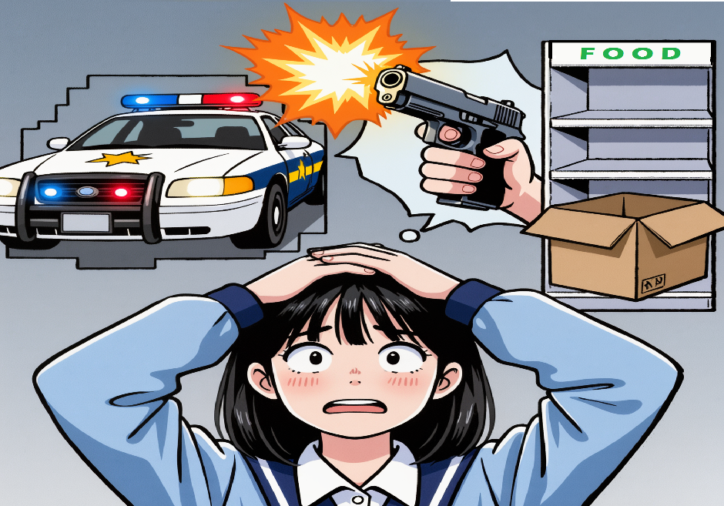
Poverty and Academic Performance
Recognizing Complex Trauma
Poverty is about more than not having stylish shoes or fashion accessories. It is about a constant struggle to survive. Cognitive load theory posits that the brain can effectively handle only so much at one time. Further, that survival concerns have greater demand for the available bandwidth than more hypothetical, “academic” concerns. (Crisis Prevention Institute, 2021)
difficulty focusing
struggling with friendships
being unusually tired
poor self-control
excessive absences
faltering academic performance
untreated medical conditions
poor hygiene
A brain imaging study conducted by Stanford supports this theory by finding children living below 150% of the federal poverty level have different structural development in regions of the brain responsible for planning, organization, and behavioral control. (Hair, 2015)
Living in hazardous places requires a hypervigilant alertness that interferes with the “gear-shifting” required to fully engage in typical classroom participation.
(Perkins, 2012)

Slide 5
Classroom Supports
Resources for Assistance
The Substance Abuse & Mental Health Services Administration (SAMHSA) promulgates 6 guiding principles for trauma informed care which can be applied to classrooms. (Resilient Educator, 2018)
Communities in Schools: This program operates from within the school. It helps provide snacks, clothes, and school supplies for students who can not afford them.
CC Police Department Facebook:
https://www.facebook.com/CorpusChristiPD/ Site posts PD involvement in community, can help develop positive view of police presence and role.
Feeding America: The largest charitable organization in the country whose mission is to help end hunger specifically in the United States. It helps families find the food they need.
www.FeedingAmerica.org
1. Safety: Throughout the school all people need to feel physically and psychologically safe.
2. Trustworthiness and transparency: Decisions should build trust between educators, students, and families.
3. Peer support: Peer support builds trust and establishes safety.
4. Collaboration and mutuality: Everyone has a role in a trauma-sensitive school. Not just counselors.
5. Empowerment, voice, and choice: Provide students an opportunity to express needs, feel calm, and be heard when those needs are met.
6. Cultural, historical, and gender issues: Ensure that interactions with students are culturally sensitive and responsive.

Slide 6
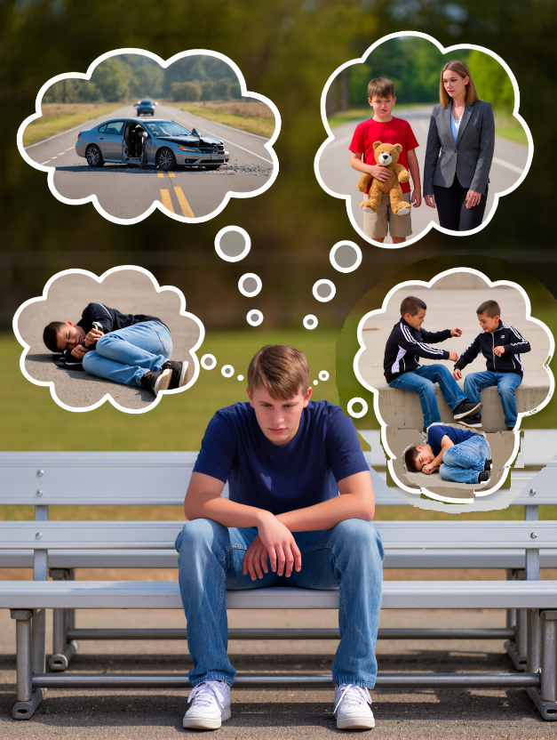
Symptoms of Teen Depression
Brandon: Depression
Brandon has had to endure a great deal of loss in his life. Losing his mother to a car accident, then losing his father and his brothers when they were given up to the foster care system stripped him of much of the stability and support he had grown accustomed to in life.
sadness
irritability
feeling worthless
anger
poor performance
poor attendance at school
feeling misunderstood
Feeling extremely sensitive
using recreational drugs or alcohol
eating or sleeping too much
self-harm
loss of interest in normal activities
avoidance of social interaction
Misguided coping attempts only made things worse. Anger and acting out got him sent to a group home where he was bullied and beaten.
Isolation, sudden traumatic change, and violence – unfortunately common experiences for foster children – create a whirlwind of mental and emotional disorientation which is a perfect recipe for depression.
Depression (Major Depressive Disorder) :
A mood disorder that causes a persistent feeling of sadness and loss of interest. It is not a passing phase or emotion, but a persistent condition. (Mayo Clinic, 2022)
(Sheppard, 2025)

Slide 7
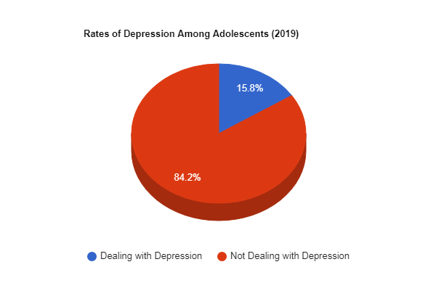
Impact on Development
Resources for Assistance
Looking at the symptoms of depression in teens, it is not difficult to see how they can have a severe impact on a child’s achievement. Depression can negatively impact a student’s attention, memory, ability to interpret, ability to concentrate, and even have physical effects.
Physical effects can be as wide ranging as headaches and fatigue, to elevated heart rate, blood pressure, and cortisol levels. (Kelly, 2019)
The American Academy of Child and Adolescent Psychiatry recommends that a parent or caretaker who suspects their child may be struggling with depression should seek help from:
1) school counselor
2) pediatrician
3) mental health professional
Teen Counseling.com is a website and app to which a caretaker can subscribe, then their child can receive counseling services via the website, emails, or even in-app text messages. https://www.teencounseling.com/
Classroom Support
Encouraging the building of strong bonds with classmates and educators creates a sense of connectedness. That connectedness assures adolescents that people care about them. (CDC, 2025)
(Wilson, 2022)

Slide 8
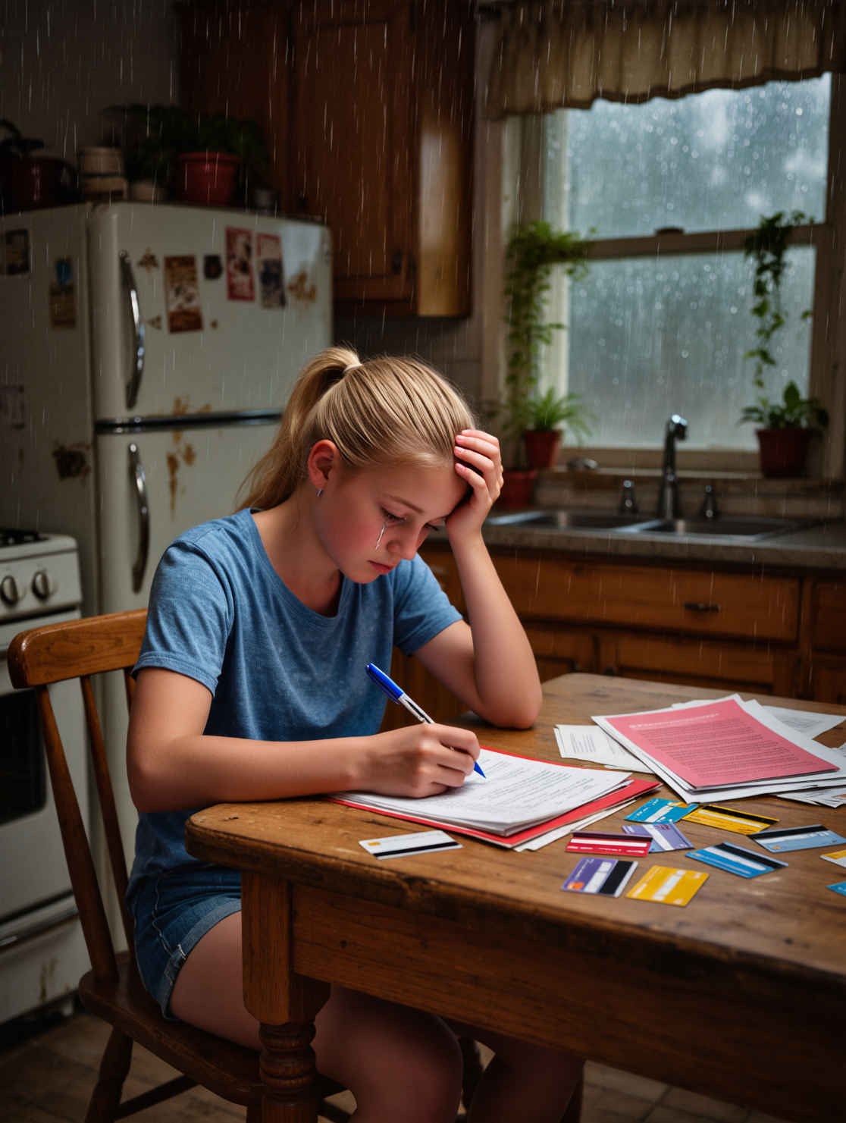
Ellie: Anxiety
Ellie has had to grow up very quickly and very early. Since her mother and father divorced – her dad chasing the road as a long-haul truck driver, and her mom wrestling with alcoholism – many of the responsibilities of maintaining the home have fallen onto Ellie’s shoulders. And to her credit, she is meeting them.
Ellie cooks, she does grocery shopping for the house, manages the household budget, pays the bills, and more. One thing she does not get to do much of however, is be a kid.
According to the International Board of Credentialing and Continuing Education Standards, an anxiety disorder can have many different causes. But they all center around fear and worry. When a young person is afraid or worried:
    about a particular event or area of life
    in a way that is extreme or age‐inappropriate
    in a way that leads to avoidance of events
    to the point of significant distress
    and it interferes significantly with daily activities,
this experience can trigger anxiety. (IBECCES, 2019)

Slide 9
Impact on Development
Classroom Support
Emotional Support: Allow student to use anxiety reducing techniques or self-calming objects
Classroom Routines: Give advance notice of planned substitute teachers, changes in routine, or transitions. Provide a signal before calling on the student and a signal for the student to opt out of answering if not up to it.
Classwork: Exempt the student from reading aloud or presenting work in front of the class. Give extended time on tests and/or a separate test-taking space. (Understood, 2025)
Anxiety can affect a student’s sleep, diet, mental and physical health, self esteem, and social interaction.
These effects can lead to poor academic performance and resistance to anything school-related.
This can include lack of engagement, poor relationships, disinterest in pursuing passions and planning for the future, poor working memory
Students with a high level of anxiety score lower on IQ and achievement tests than their peers.
. (IBCCES, 2019)
Resources for Assistance
National Alliance on Mental Illness (NAMI) of Corpus Christi: 361-510-6939
https://namigcc.org/about-nami-greater-corpus-christi/
Nueces Center for Mental Health and Intellectual Disabilities
(NCMHID): 361-886-6900,
https://www.ncmhid.org/crisis-intervention

Slide 10

Ian: Overcoming Child Neglect
Child neglect is an often overlooked form of maltreatment. It is often not a product of malice, or violence, or anger. In many cases not only is it unintentional, but it results from the very efforts of caretakers to provide. As caretakers try their hardest to provide for their children…financially…they wind up working such long hours that they are not there to provide the just as important needs their children have physically, psychologically, or emotionally. It is not surprising then, that neglect is the most common form of maltreatment in the United States. (Logan-Greene, 2015)
Ian’s case is a perfect example of this dynamic. After his mom left, his dad was forced to work long hours to provide for the family on his own. So dad has not been present at home to interact with his son as much as he wishes he could, or to be the role-model he would like to be.
The impact on Ian is clear. Ian is an angry young man. He does not know how to make and keep friends. He is a bully. He doesn’t fail but just skates by. He doesn’t seem to take an interest in anything social, extracurricular, or academic.

Slide 11
Impact on Development
Studies have shown that parental absence is negatively associated with child development. Neglected children have lower cognitive test scores and academic test scores. They are less likely to go to college. The absence of a mother seems to have an especially persistent negative effect on a child’s development. (Zang, 2020)
From the earliest days of infancy human beings seek connection. As babies, we desperately seek out new ways to communicate through cooing, crying, facial expressions, and gestures. When an adult “returns the serve” by cooing back, or mimicking an expression or gesture, the baby’s effort is rewarded. A connection is made. A bond is formed. And that bond is strengthened with every subsequent interaction. The baby smiles and laughs…and grows. (Harvard, 2023)
Such interactions literally shape the architecture of the developing brain. This continues through childhood and adolescence. But if those interactions are absent, or severely lacking, that development can also wind up being absent or lacking. (Harvard, 2023)
When natural and expected responses are lacking, natural development is threatened which triggers biological threat response systems which can have toxic effects on the brain. Physical effects. (Harvard, 2023)
Research also shows that neglect leads to higher incidences of aggression, discipline referrals, and suspensions. (Kendall-Tackett, 1996)
Recognizing Neglect
Physical Signs: unexplained injuries, excessive absences, poor hygiene, malnutrition
Emotional Signs: withdrawal, fear, low self esteem, clinginess
Behavioral Signs: sudden academic decline, increased aggressiveness, distrustful of others
(Teachers.Institute, 2023)

Slide 12
Community Resources
Classroom Support
Circles of Care (Counseling for Youth and Families)
852-3812 or 1-866-63-CHILD (24453) | 5333 Everhart, 150B, CC, TX 78411
www.circlesofcareinc.org
Counseling & Training Clinic-Texas A&M University
Free of charge | 361-825-3988 | 6300 Ocean Drive, Natural Resource Center, CC, TX 78412
www.cnep.tamucc.edu/ctc.html
Department of Family & Protective Services (Local Offices)
361-854-2011 | 4201 Greenwood Dr., CC, TX 78416
361-855-9924 | 5155 Flynn Pkwy CC, TX 78411
www.dfps.state.gov
(Calallen, 2025)
Build Trust * Encourage Open Expression * Provide Routine and Stability * Recognize Severe Cases * Create Safe Spaces * Provide Emotional Support * Set Appropriate Boundaries * Encourage Group Work When Possible (Teachers.Institute, 2023)
Educators are mandatory reporters. That means we are legally required to report suspicions of child abuse or neglect to the proper authorities. Not doing so could result in legal consequences.
(Teachers.Institute, 2023)

Slide 13

Conclusion
As we examined the issues facing Nelly, Brandon, Ellie, and Ian, we have seen just how big of an obstacle each can be to the success of our students. We can teach and teach and teach all day, but if we are trying to teach a student who just lost a parent, or who has not eaten in two days, our efforts are both extremely likely to fail, and even more fundamentally entirely misguided.
We must take the time to build relationships with our students. Many of the issues we examined today have very similar telltales in the classroom. Sudden decline in academic performance, unexplained injuries or withdrawal, tiredness, or anger. Knowing who our students are – as people – can help us more readily recognize when something is amiss. When something is off. That is a critical ability we need to develop.
We should train ourselves to see every student as a unique individual young person making their way through a very challenging part of their lives. Not simply as “robots” built
to download information. We are the ones lucky enough to get to walk along side them on that incredible journey. So, let us be good traveling companions; good guides. Teach ourselves to meet
them where they are, identify their needs, and commit ourselves to supporting them to the absolute best of our ability every step of the way.

Slide 14
Bibliography
Gunn, Jennifer, How Adverse Childhood Trauma Affects a Student's Brain - Resilient Educator, 2018.
https://resilienteducator.com/classroom-resources/this-is-a-students-brain-on-trauma/
Harvard University, Center on the Developing Child, InBrief- The Science of Neglect, 2013.
https://developingchild.harvard.edu/resources/inbriefs/inbrief-the-science-of-neglect/
Chen, Jingjing, Learning and memory under stress- implications for the classroom – Nature Partner, 2023.
https://www.nature.com/articles/npjscilearn201611
Zang, Lijun, The Effects of Parental Absence on Children Development- Left-Behind Children in China – PMC
https://pmc.ncbi.nlm.nih.gov/articles/PMC7559575/
Kendall-Tackett, The effects of neglect on academic achievement and disciplinary problems, 1996.
https://pubmed.ncbi.nlm.nih.gov/8734546/
Resilient Educator, Trauma-Informed Teaching Tips for Classroom & Online Educators, 2018. https://resilienteducator.com/classroom-resources/trauma-informed-teaching-tips/

Slide 15
Bibliography
Hornor, Gail, DNP CPNP, Childhood Trauma Exposure and Toxic Stress- - Journal of Pediatric Health Care, 2015.
https://www.jpedhc.org/article/s0891-5245(14)00344-7/fulltext
Calallen High Shool, Community Resources List, 2025.
https://chs.calallen.org/high-school-counselors/community-resources
CDC, Centers for Disease Control, 2025, Data and Statistics on Children's Mental Health
https://www.cdc.gov/children-mental-health/data-research/index.html
Harms, Madeline, Disrupting links between poverty, chronic stress, and educational inequality – Nature Partner
https://www.nature.com/articles/s41539-023-00199-2
Understood.org, Classroom Accommodations for Anxiety, 2024.
https://cdn-assets.understood.org/p0qf7j048i0q/4Tpnck45YT23cvIPAi8CE6/656fb3f5c2f53c8f704e429dbc2e8320/
Classroom_accommodations_for_anxiety_Understood_Accessible.pdf
Teachers Institute, Helping Neglected and Abused Children- A Guide for Teachers and Parents, 2025. https://teachers.institute/socio-emotional-development-children/helping-neglected-abused-children-guide/

Slide 16
Bibliography
Mayo Clinic, Depression (Major Depressive Disorder), 2022.
https://www.mayoclinic.org/diseases-conditions/depression/symptoms-causes/syc-20356007
Teen Counseling.com, Help Your Child Thrive With Professional Counseling, 2025.
https://www.teencounseling.com/
Kelly, John, PhD, 6 Ways Teachers Can Help Fight Depression and Mental Health Disorders, 2019
https://ibcces.org/blog/2019/03/12/teachers-fight-depression-mental-health-disorders/
IBCCES, Impact of Anxiety and Depression on Student Academic Success, 2019.
https://ibcces.org/blog/2019/05/01/impact-anxiety-depression-student-progress/
Sheppard, Sarah, The Mental Health Effects of Living in Foster Care, Effects can linger into adulthood , 2024.
https://www.verywellmind.com/the-mental-health-effects-of-living-in-foster-care-5216614
Hair, Nicole, Association of Child Poverty, Brain Development, and Academic Achievement, JAMA Ped. 2015.
https://pmc.ncbi.nlm.nih.gov/articles/PMC4687959/

Slide 17
Bibliography
Crisis Prevention Institute, The Impact of Stress & Trauma on Student Behavior & Academic Performance), 2024.
https://www.crisisprevention.com/blog/education/the-impact-of-stress-and-trauma-on-student-behavior-and-academic-performance/
Perkins, Suzanne, Violence Exposure and the Development of School-Related Functioning: Mental Health, Neuro-cognition, and Learning, 2012.
https://pmc.ncbi.nlm.nih.gov/articles/PMC3402358/
Feeding America.org, Our Vision: An America without Hunger, 2025.
https://www.feedamerica.org/

